Slide 1

Buggy
Quality Metrics
Rev 1.0
May Tan Kah Noi
AO-QD
May 15, 2020
HP Confidential Quality Metrics (150502)filename.ppt
May 15, 2002
page <number>

Slide 2

What will be measured / monitored?
For the Buggy program, 4 metrics will be tracked for Quality:
  Total Failure Rate (TFR)
  Cumulative Failure Rate (CFR)
  Customer Satisfaction Audit (CSA)
  Quality Incidence (QI)
HP Confidential Quality Metrics (150502)filename.ppt
May 15, 2002
page <number>

Slide 3

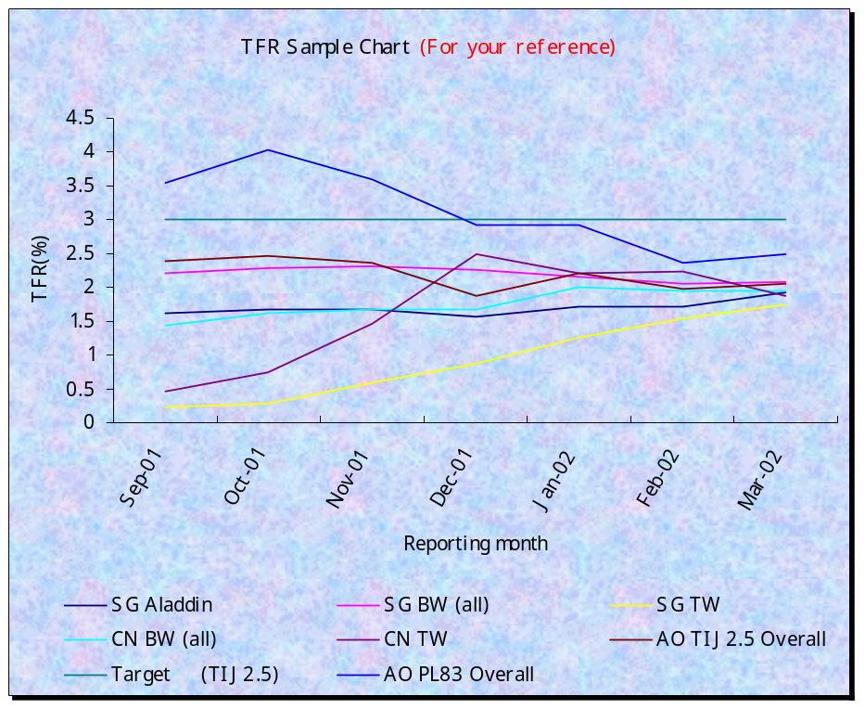
Total Failure Rate (TFR)
Definition:
Total Failure Rate:
Measures the percentage of products under warranty that is falling out in the field in one year
Objective:
To monitor product failure rate on a monthly basis, based on the sell-through information from the WMS*.
*Before WMS can support (data by MO), data will come from Patricia Coulthard (VPP).
Calculation:
# units failed in that reporting month
* 12 * 100
# units under warranty for past 12 months
Goal:
Program goal: 2%
Predicted TFR (@MR): ~5.6%
Suggest using 3% as goal (to monitor and adjust accordingly as AFR improvements are implemented). 2% can be an aspiration goal.
Key things to do….
To monitor trends
Identify top issues / key offenders (warranty
data analysis, FFA)
Work on improvements
HP Confidential Quality Metrics (150502)filename.ppt
May 15, 2002
page <number>

Slide 4
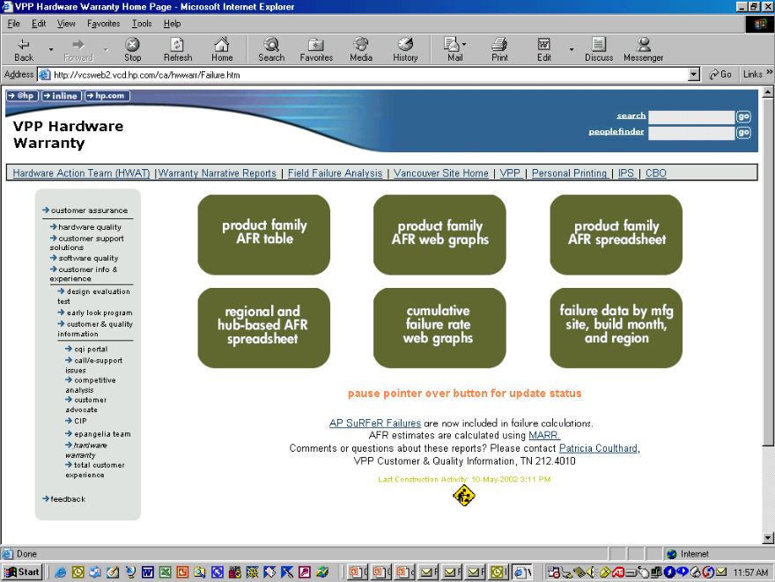
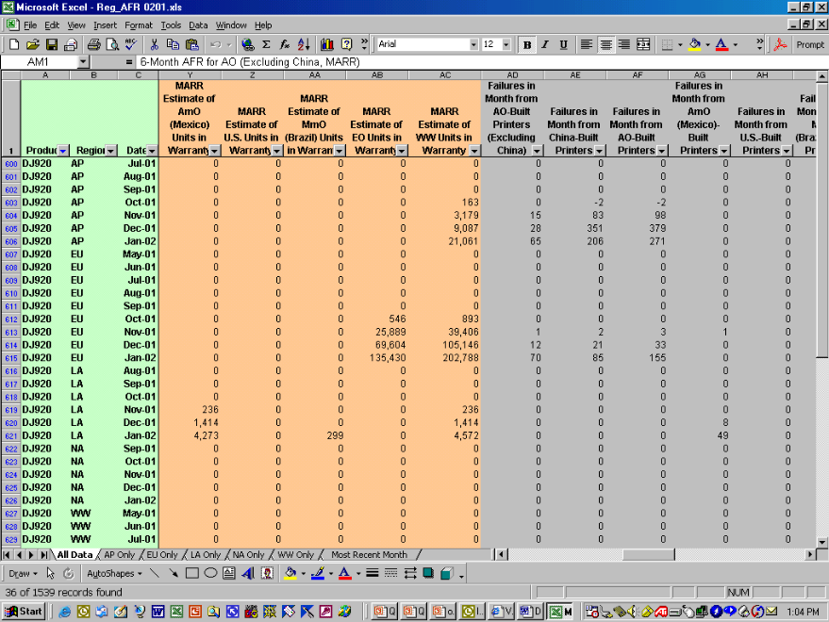
TFR Data Source
WMS:
Intention is to have a one-stop location to obtain all warranty data → the WMS system.
However WMS currently shows data at an overall WW level, ie. Does not filter down to MO/CM level (unable to monitor respective satellite performance).
Therefore, need to find another data source for all to use until WMS can support.
VPP Data (Interim Solution):
Patricia Coulthard (VPP) compiles the warranty data on a monthly basis and publishes it in the VPP Warranty web: (http://vcsweb2.vcd.hp.com/ca/hwwarr/Failure.htm)
The spreadsheet breaks down the data into individual mfg sites and by product model. Both ‘MARR’ and ‘traditional’ numbers are there but ‘traditional’ data should be used to represent TFR at this point of time.
The aim for all to use this data is to have a consistent data source to monitor the warranty trends (ie. Common source used among all satellites).
Warranty base and failure return #’s by mfg sites (eg. AG-SG, MmO (Brazil),…)
Regional data (eg AP, EU..)
HP Confidential Quality Metrics (150502)filename.ppt
May 15, 2002
page <number>

Slide 5

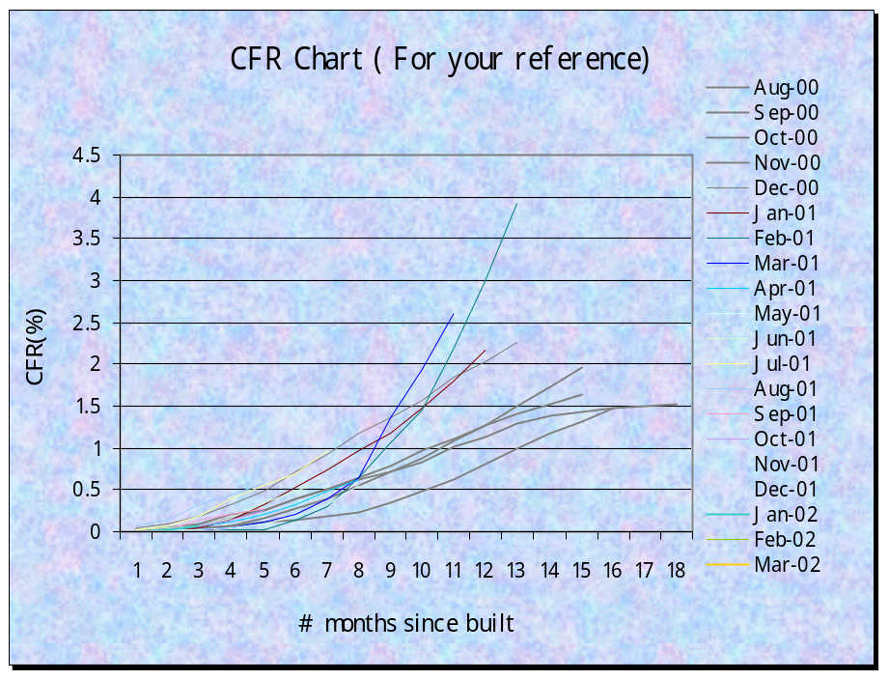
Cumulative Failure Rate (CFR)
Definition:
Cumulative Failure Rate:
Measures the cumulative % of built month’s units that failed after a period of time.
Objective:
Comparative measure of different built month’s performance.
To monitor product failure rate based on its built month.
Calculation:
(
# units failed from that built mth in current reporting mth
+
Total # units built in that built mth
)
 Previous mth’s # units failed from that built mth
* 100
Key things to do….
To monitor trends
Identify affected built months
Work on improvements (apply learning from affected
months to current production)
Total # units built in that built mth
Goal:
CFR will be used as a monitoring tool to see whether built month’s performance is improving or not (no goal).
HP Confidential Quality Metrics (150502)filename.ppt
May 15, 2002
page <number>

Slide 6
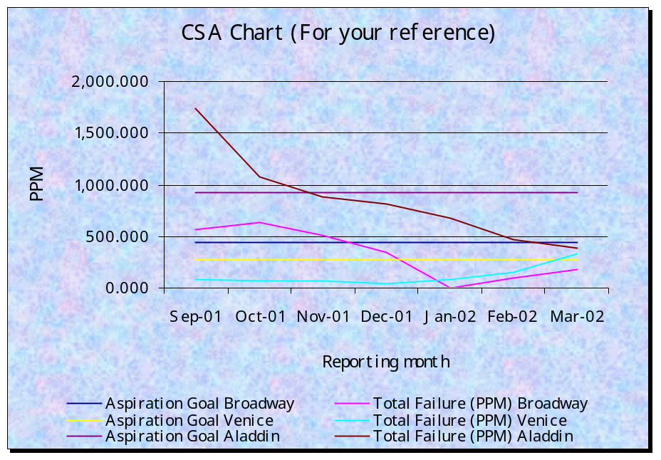
Customer Satisfaction Audit (CSA)
Definition:
Customer Satisfaction Audit:
Audit to check performance (quality) of the units after Final Test and prior to packing (bulkpack/endpack) via visual and functional checks.
Objective:
To monitor product failure rate (PPM) at end-of-line with sampling size based on ANSI/ASQC Z1.4 and MIL- STD-105E.
Calculation:
# units failed in audit
Total # units audited
* 1000000
Goal:
CSA goal: 20000 PPM (2%)
Goal to be reviewed periodically and adjusted accordingly
Key things to do….
To monitor trends
To monitor reoccurrences
Work on improvements (CA for issues and addressing
ineffective CA causing reoccurrences)
HP Confidential Quality Metrics (150502)filename.ppt
May 15, 2002
page <number>

Slide 7
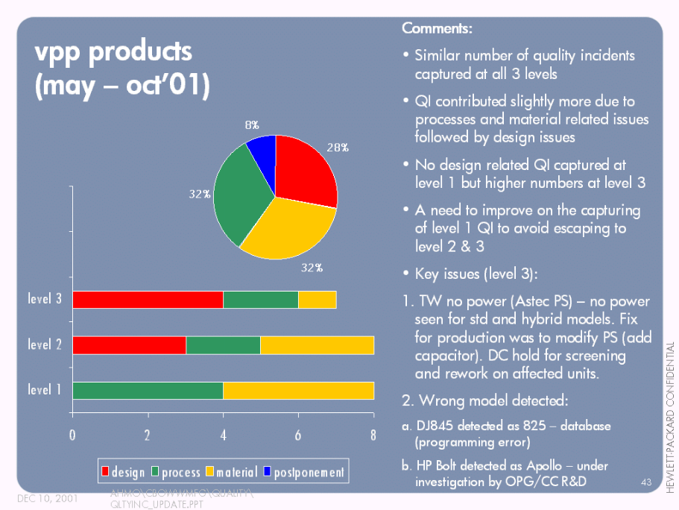
Quality Incidence (QI)
Definition:
Quality Incidence:
Incidents which reduce production efficiency due to quality that happened to customer shippable products.
Objective:
Measure of the execution of Total Quality Mgmt from product quality perspective.
To monitor product issues that have occurred from manufacturing level to customers’ hands.
Method:
Categorize by supply chain: within factory, within HP, and escape outside HP.
Categorized by value chain: design, material, and process.
Cost of QI tracked: $cost, # of units affected.
Goal:
Goal to be set based on # of QI initiated.
TBD: monitor initial post MR performance and set goal accordingly.
Key things to do….
To enter QI into WW QI database (timely entering)
Monitor trends
Work on improvements (CA for QI / closure to all QI)
HP Confidential Quality Metrics (150502)filename.ppt
May 15, 2002
page <number>

Slide 8
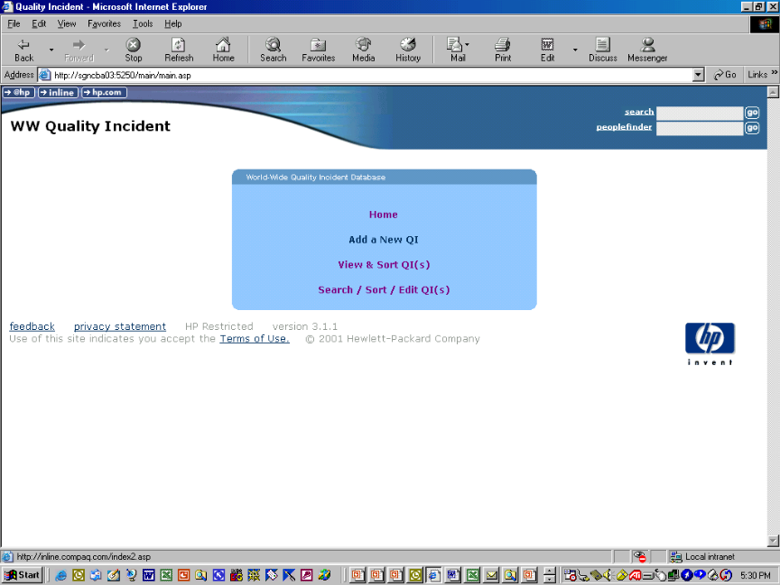
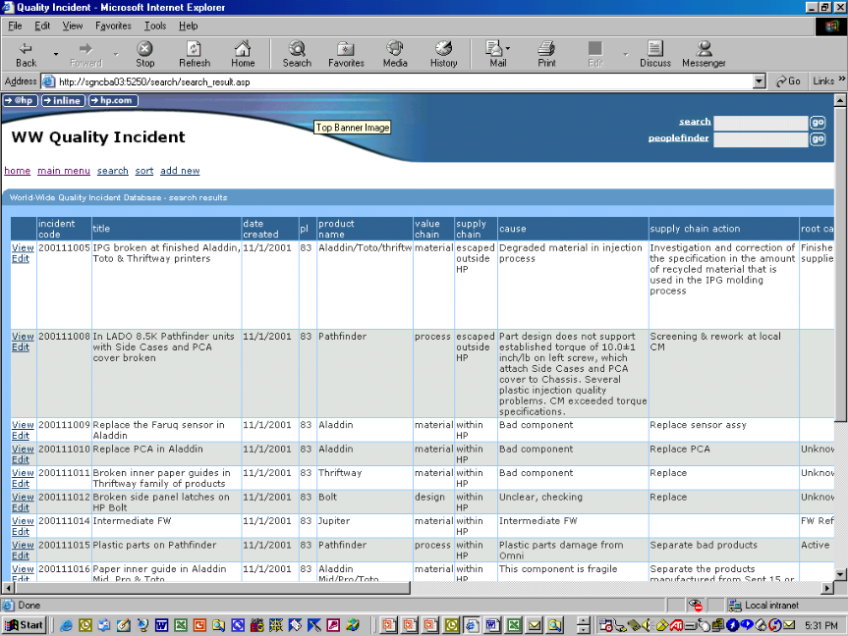
QI Database
QI WW Database:
A web-based database established to capture all QI. The link to the database is:
http://ao.sgp.hp.com/wwqi/index.htm
(Password is needed for access)
Features:
Key fields in database to capture info:
  value chain
  supply chain
  cause
  action (supply chain & root cause)
  impact statement
  $cost
  MO/DC
Search engine to find / sort QI’s (eg. By product model, by supply chain, etc)
Key Benefit:
Centralized database for WW QI
Provides means to track and follow-up on issues
HP Confidential Quality Metrics (150502)filename.ppt
May 15, 2002
page <number>

Slide 9
